Slide 1
DASC 5301-002
Principal Component Analysis
Dr Subharag Sarkar
Fall 2023
Slides Courtesy - Rózsa Záruba

Slide 2
Curse of Dimensionality

Slide 3
Curse of Dimensionality
Dimensionality in a dataset becomes a severe impediment to achieve a reasonable efficiency for most algorithms.
Increasing the number of features does not always improve accuracy.
When data does not have enough features, the model is likely to underfit, and when data has too many features, it is likely to overfit.
Hence it is called the curse of dimensionality.
The curse of dimensionality is an astonishing paradox for data scientists, based on the exploding amount of n-dimensional spaces — as the number of dimensions, n, increases.

Slide 4
Curse of Dimensionality
Increasing the number of features will not always improve classification accuracy.
In practice, the inclusion of more features might actually lead to worse performance.
The number of training examples required increases exponentially with dimensionality d (i.e., k^{d}).
k=3
3¹ bins
3² bins
k: number of bins per feature
3³ bins

Slide 5
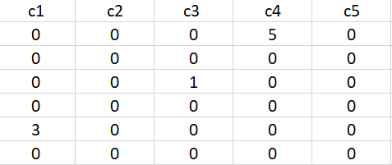
Sparseness
The sparseness of data is the property of being scanty or scattered.
It lacks denseness, and high percentage of the variable’s cells do not contain actual data.
Fundamentally its full of “empty” or “N/A” values.
Points in an n-dimensional space frequently become sparse as the number of dimensions grows.
The distance between points will extend to grow as the number of dimensions increases.

Slide 6
Implications of the Curse of Dimensionality
There are few implications of the curse of dimensionality:
Optimization problems will be infeasible as the number of features increases.
Due to the absolute scale of inherent points in an n-dimensional space, as n maintains to grow, the possibility of recognizing a particular point (or even a nearby point) proceeds to fall.

Slide 7
Dimensionality Reduction

Slide 8
Dimensionality Reduction
What is the objective?
Choose an optimum set of features of lower dimensionality to improve classification accuracy.
Different methods can be used to reduce dimensionality:
Feature extraction
Feature selection

Slide 9
Dimensionality Reduction
Dimensionality reduction eliminates some features of the dataset and creates a restricted set of features that contains all of the information needed to predict the target variables more efficiently and accurately.
Reducing the number of features normally also reduces the output variability and complexity of the learning process.
The covariance matrix is an important step in the dimensionality reduction process.
It is a critical process to check the correlation between different features.

Slide 10

Correlation and its Measurement
There is a concept of correlation in machine learning that is called multicollinearity.
Multicollinearity exists when one or more independent variables highly correlate with each other.
Multicollinearity makes variables highly correlated to one another, which makes the variables’ coefficients highly unstable

Slide 11
The Covariance Matrix and Heatmap
The covariance matrix is the first step in dimensionality reduction because it gives an idea of the number of features that strongly relate, and it also gives an idea of the number of strongly related features so that those features can be discarded.
It also gives the detail of all independent features.
It provides an idea of the correlation between all the different pairs of features.

Slide 12
Dimensionality Reduction
Feature extraction: finds a set of new features (i.e., through some mapping f()) from the existing features.
Feature selection: chooses a subset of the original features.
The mapping f() could be linear or non-linear
Notes:
Feature selection is the process of reducing the number of input variables when developing a predictive model. It is desirable to reduce the number of input variables to both reduce the computational cost of modeling and, in some cases, to improve the performance of the model. Statistical-based feature selection methods involve evaluating the relationship between each input variable and the target variable using statistics and selecting those input variables that have the strongest relationship with the target variable. These methods can be fast and effective, although the choice of statistical measures depends on the data type of both the input and output variables.

Slide 13
Feature Extraction
Linear combinations are particularly attractive because they are simpler to compute and analytically tractable.
Given x ϵ R^{N}, find an K x N matrix T such that:
y = Tx ϵ R^{K} where K<<N
This is a projection from the N-dimensional space to a K-dimensional space.
X is the old set of dimensions and Y is the new set of dimensions
T
Notes:
Feature extraction refers to the process of transforming raw data into numerical features that can be processed while preserving the information in the original data set. It yields better results than applying machine learning directly to the raw data.
Feature extraction can be accomplished manually or automatically:
Manual feature extraction requires identifying and describing the features that are relevant for a given problem and implementing a way to extract those features. In many situations, having a good understanding of the background or domain can help make informed decisions as to which features could be useful. Over decades of research, engineers and scientists have developed feature extraction methods for images, signals, and text. An example of a simple feature is the mean of a window in a signal.
Automated feature extraction uses specialized algorithms or deep networks to extract features automatically from signals or images without the need for human intervention. This technique can be very useful when you want to move quickly from raw data to developing machine learning algorithms. Wavelet scattering is an example of automated feature extraction.

Slide 14
Feature Extraction (cont’d)
From a mathematical point of view, finding an optimum mapping y=𝑓(x) is equivalent to optimizing an objective criterion.
Different methods use different objective criteria, e.g.,
Minimize Information Loss: represent the data as accurately as possible in the lower-dimensional space.
Maximize Discriminatory Information: enhance the class-discriminatory information in the lower-dimensional space.

Slide 15
Feature Extraction (cont’d)
Popular linear feature extraction methods:
Principal Components Analysis (PCA): Seeks a projection that preserves as much information in the data as possible.
Linear Discriminant Analysis (LDA): Seeks a projection that best discriminates the data.
Many other methods:
Making features as independent as possible (Independent Component Analysis or ICA).
Retaining interesting directions (Projection Pursuit).
Embedding to lower dimensional manifolds (Isomap, Locally Linear Embedding or LLE).

Slide 16
Principal Component Analysis

Slide 17
Principal Component Analysis (PCA)
Principal Component Analysis (PCA) is an exploratory approach to reduce the data set's dimensionality to 2D or 3D, used in exploratory data analysis for making predictive models.
Principal Component Analysis is a linear transformation of data set that defines a new coordinate rule such that:
The highest variance by any projection of the data set appears to lay on the first axis.
The second biggest variance on the second axis, and so on.

Slide 18
Principal Component Analysis
It is the most common form of factor analysis
The new variables/dimensions are:
Linear combinations of the original ones
Uncorrelated with one another
Orthogonal in original dimension space
Capture as much of the original variance in the data as possible
Called Principal Components

Slide 19
Principal Components
First principal component is the direction of greatest variability (covariance) in the data.
Second is the next orthogonal (uncorrelated) direction of greatest variability.
So first remove all the variability along the first component, and then find the next direction of greatest variability.
And so on …

Slide 20
Principal Components Analysis (PCA)
Principle:
Linear projection method to reduce the number of parameters
Transfer a set of correlated variables into a new set of uncorrelated variables
Map the data into a space of lower dimensionality
Form of unsupervised learning
Properties:
It can be viewed as a rotation of the existing axes to new positions in the space defined by original variables
New axes are orthogonal and represent the directions with maximum variability

Slide 21
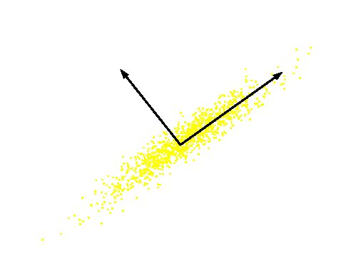
What are the new axes?
Original Variable B
PC 2
PC 1
Original Variable A
Orthogonal directions of greatest variance in data
Projections along PC1 discriminate the data most along any one axis

Slide 22
Use-Cases of PCA
We can use principal component analysis (PCA) for the following purposes:
To reduce the number of dimensions in the dataset.
To find patterns in the high-dimensional dataset
To visualize the data of high dimensionality
To ignore noise
To improve classification
To gets a compact description
To capture as much of the original variance in the data as possible

Slide 23
Objective of PCA
Mathematically the main objective of PCA is to:
Find an orthonormal basis for the data.
Sort dimensions in the order of importance.
Discard the low significance dimensions.
Focus on uncorrelated and Gaussian components.

Slide 24
Steps involved in PCA
Standardize the PCA.
Calculate the covariance matrix.
Find the eigenvalues and eigenvectors for the covariance matrix.
Plot the vectors on the scaled data.

Slide 25
Example
There are 100 students in a class with m different features like grade, age, height, weight, hair color, and others.
Most of the features may not be relevant that describe the student. Therefore, it is vital to find the critical features that characterize a student.
Some analysis based on the observation of different features of a student:
Every student has a vector of data that defines him the length of m. e.g. (height, weight, hair_color, grade,….) or (181, 68, black, 99, ….).
Each column is one student vector. So, n = 100.
It creates an m*n matrix.
Each student lies in an m-dimensional vector space.

Slide 26
Features to Ignore & Keep
Features to Ignore
Collinear features or linearly dependent features. e.g., leg size and height.
Noisy features that are constant. e.g., the thickness of hair
Constant features. e.g., Number of teeth.
Features to Keep:
Non-collinear features or low covariance.
Features that change a lot, high variance. e.g., grade.

Slide 27
Math behind the PCA
Eigenvectors and Eigenvalues
The eigenvectors and eigenvalues ​​of a covariance matrix (or correlation) describe the source of the PCA.
Eigenvectors (main components) determine the direction of the new attribute space, and eigenvalues ​​determine its magnitude.
The PCA’s main objective is to reduce the data’s dimensionality by projecting it into a smaller subspace, where the eigenvectors form the axes.

Slide 28
Math behind the PCA
Eigenvectors and Eigenvalues
However, the eigenvectors define only the new axes’ directions because they all have a size of 1.
Consequently, to decide which eigenvector(s), we can discard without losing much information in the subspace construction and checking the corresponding eigenvalues.
The eigenvectors with the highest values ​​are the ones that include more information about the distribution of our data.

Slide 29
Applications of PCA
Data Visualization.
Data Compression.
Noise Reduction.
Data Classification.
Image Compression.
Face Recognition.

Slide 30
PCA Algorithm
Step-01: Get data.
Step-02: Compute the mean vector (µ).
Step-03: Subtract mean from the given data.
Step-04: Calculate the covariance matrix.
Step-05: Calculate the eigen vectors and eigen values of the covariance matrix.
Step-06: Choose components and form a feature vector.
Step-07: Deriving the new data set.

Slide 31
Problem-01:
Given data = { 2, 3, 4, 5, 6, 7 ; 1, 5, 3, 6, 7, 8 }.
Compute the principal component using PCA Algorithm.

Slide 32
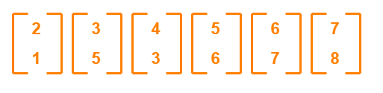
Step 1
Get data.
The given feature vectors are:
x₁ = (2, 1)
x₂ = (3, 5)
x₃ = (4, 3)
x₄ = (5, 6)
x₅ = (6, 7)
x₆ = (7, 8

Slide 33
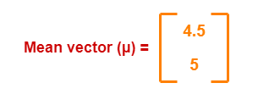
Step 2
Calculate the mean vector (µ).
Mean vector (µ)
= ((2 + 3 + 4 + 5 + 6 + 7) / 6, (1 + 5 + 3 + 6 + 7 + 8) / 6)
= (4.5, 5)
Thus,

Slide 34
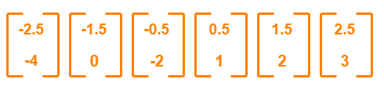
Step 3
Subtract mean vector (µ) from the given feature vectors.
x₁ – µ = (2 – 4.5, 1 – 5) = (-2.5, -4)
x₂ – µ = (3 – 4.5, 5 – 5) = (-1.5, 0)
x₃ – µ = (4 – 4.5, 3 – 5) = (-0.5, -2)
x₄ – µ = (5 – 4.5, 6 – 5) = (0.5, 1)
x₅ – µ = (6 – 4.5, 7 – 5) = (1.5, 2)
x₆ – µ = (7 – 4.5, 8 – 5) = (2.5, 3)
Feature vectors (x_{i}) after subtracting mean vector (µ) are-

Slide 35
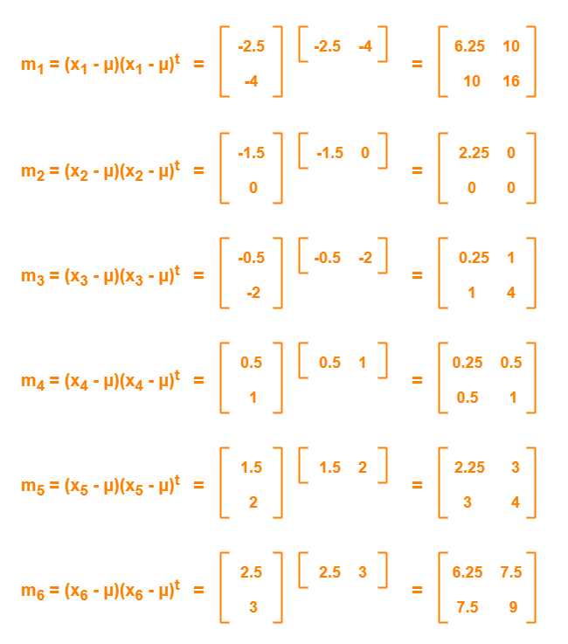
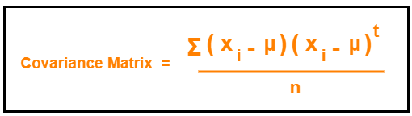
Step 4
Calculate the covariance matrix.
Covariance matrix is given by-

Slide 36
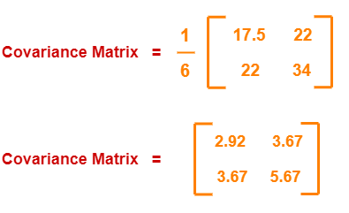
Step 4 cont.
Covariance matrix
= (m₁ + m₂ + m₃ + m₄ + m₅ + m₆) / 6
On adding the above matrices and dividing by 6, we get-

Slide 37
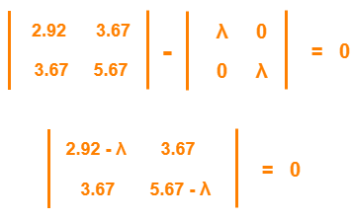
Step 5
Calculate the eigen values and eigen vectors of the covariance matrix.
λ is an eigen value for a matrix M if it is a solution of the characteristic equation |M – λI| = 0.

Slide 38
Step 5
From here,
(2.92 – λ)(5.67 – λ) – (3.67 x 3.67) = 0
16.56 – 2.92λ – 5.67λ + λ² – 13.47 = 0
λ² – 8.59λ + 3.09 = 0
Solving this quadratic equation, we get
λ = 8.22, 0.38
Thus, two eigenvalues are λ₁ = 8.22 and λ₂ = 0.38.
Notes:
Clearly, the second eigen value is very small compared to the first eigen value. So, the second eigen vector can be left out.

Slide 39
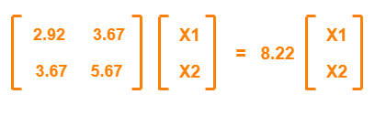
Step 6
Eigen vector corresponding to the greatest eigenvalue is the principal component for the given data set => we find the eigenvector corresponding to eigenvalue λ₁.
Use the following equation to find the eigenvector->
MX = λX
where
M = Covariance Matrix
X = Eigen vector
λ = Eigen value
Solving these, we get:
2.92X₁ + 3.67X₂ = 8.22X₁
3.67X₁ + 5.67X₂ = 8.22X₂
On simplification, we get-
5.3X₁ = 3.67X₂ ………(1)
3.67X₁ = 2.55X₂ ………(2)

Slide 40
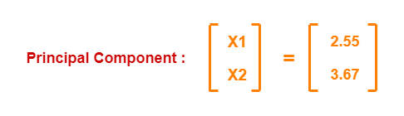
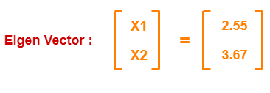
Step 6 (Contd)
From (1) and (2), X₁ = 0.69X₂
From (2), the eigenvector is:
Principal component for the given data set is

Slide 41
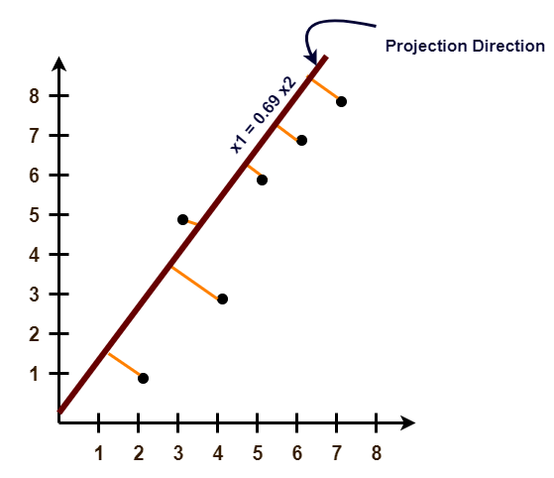
Project the data points onto the new subspace

Slide 42
Why Factor or Component Analysis

Slide 43
Why Factor or Component Analysis?
We study phenomena that can not be directly observed
ego, personality, intelligence in psychology
Underlying factors that govern the observed data
We want to identify and operate with underlying latent factors rather than the observed data
E.g. topics in news articles
Transcription factors in genomics
We want to discover and exploit hidden relationships
“beautiful car” and “gorgeous automobile” are closely related
So are “driver” and “automobile”
But does your search engine know this?
Reduces noise and error in results

Slide 44
Why Factor or Component Analysis?
We have too many observations and dimensions
To reason about or obtain insights from
To visualize
Too much noise in the data
Need to “reduce” them to a smaller set of factors
Better representation of data without losing much information
Can build more effective data analyses on the reduced-dimensional space: classification, clustering, pattern recognition
Combinations of observed variables may be more effective bases for insights, even if physical meaning is obscure

Slide 45
Factor or Component Analysis
Discover a new set of factors/dimensions/axes against which to represent, describe or evaluate the data
For more effective reasoning, insights, or better visualization
Reduce noise in the data
Typically a smaller set of factors: dimension reduction
Better representation of data without losing much information
Can build more effective data analyses on the reduced-dimensional space: classification, clustering, pattern recognition
Factors are combinations of observed variables
May be more effective bases for insights, even if physical meaning is obscure
Observed data are described in terms of these factors rather than in terms of original variables/dimensions

Slide 46
Basic Concept
Areas of variance in data are where items can be best discriminated and key underlying phenomena observed
Areas of greatest “signal” in the data
If two items or dimensions are highly correlated or dependent
They are likely to represent highly related phenomena
If they tell us about the same underlying variance in the data, combining them to form a single measure is reasonable
Parsimony
Reduction in Error
So we want to combine related variables, and focus on uncorrelated or independent ones, especially those along which the observations have high variance
We want a smaller set of variables that explain most of the variance in the original data, in more compact and insightful form

Slide 47
Basic Concept
What if the dependences and correlations are not so strong or direct?
And suppose you have 3 variables, or 4, or 5, or 10000?
Look for the phenomena underlying the observed covariance/co-dependence in a set of variables
Once again, phenomena that are uncorrelated or independent, and especially those along which the data show high variance
These phenomena are called “factors” or “principal components” or “independent components,” depending on the methods used
Factor analysis: based on variance/covariance/correlation
Independent Component Analysis: based on independence

Slide 48
How Many PCs?
For n original dimensions, correlation matrix is nxn, and has up to n eigenvectors. So, n PCs.
Where does dimensionality reduction come from?

Slide 49
PCs, Variance and Least-Squares
The first PC retains the greatest amount of variation in the sample
The k^{th} PC retains the k^{th} greatest fraction of the variation in the sample
The k^{th} largest eigenvalue of the correlation matrix C is the variance in the sample along the k^{th} PC
The least-squares view: PCs are a series of linear least squares fits to a sample, each orthogonal to all previous ones

Slide 50
Principle Components
Can ignore the components of lesser significance.
You do lose some information, but if the eigenvalues are small, you don’t lose much
n dimensions in original data
calculate n eigenvectors and eigenvalues
choose only the first p eigenvectors, based on their eigenvalues
final data set has only p dimensions

Slide 51
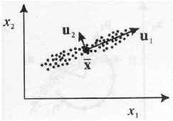
Interpretation of PCA
PCA chooses the eigenvectors of the covariance matrix corresponding to the largest eigenvalues.
The eigenvalues correspond to the variance of the data along the eigenvector directions.
Therefore, PCA projects the data along the directions where the data varies most.
PCA preserves as much information in the data by preserving as much variance in the data.
u₁: direction of max variance
u₂: orthogonal to u₁

Slide 52
Data Normalization
The principal components are dependent on the units used to measure the original variables as well as on the range of values they assume.
Data should always be normalized prior to using PCA.
A common normalization method is to transform all the data to have zero mean and unit standard deviation:
where μ and σ are the mean and standard
deviation of the i-th feature x_{i}

